Slide 1
Introduction to the
McKinney-Vento Act & Rights of Students in Temporary Housing (NYC)
Presented by the New York State Technical and Education Assistance Center for Homeless Students (NYS-TEACHS)

Slide 2
About This Presentation & NYS-TEACHS
About this presentation: These slides were drafted by NYS-TEACHS. If you edit slides, please remove “NYS-TEACHS” from the footer of the slide and include a note about the author of any new content.
About NYS-TEACHS: New York State Technical and Education Assistance Center for Homeless Students
  NYS-TEACHS is funded by the New York State Education Department and housed at Advocates for Children of New York. The content of this presentation does not necessarily reflect the views or policies of the New York State Education Department.
  NYS-TEACHS provides technical assistance on homeless education issues. Services include:
    Hotline (800-388-2014)
    Website (www.nysteachs.org)
    Webinars, Annual Workshops, and On-Site Trainings
    Outreach Materials

Slide 3
New York City Students Experiencing Homelessness
Key Takeaways presented by the Institute for Children, Poverty, and Homelessness’ in their Atlas of Student Homelessness 2017 include:
More than 140,000 New York City public school students have been homeless at some point between SY 2010–11 and SY 2015–16.
Close to 100,000 homeless students attended New York City public schools in SY 2015–16. This was a 49% increase in six years. Over the same period, the overall enrollment among housed students declined.
Amidst citywide policy and curricula changes over time, achievement gaps by housing status persisted. Homeless students scored proficient in ELA at roughly half the rate of housed students overall (21% to 40% in SY 2015–16).
Homeless students dropped out of high school at two times the rate of low-income housed students and over three times the rate of non-low-income housed students (17% to 8% and 6%).
Notes:
On the Map: The Atlas of Student Homelessness in New York City 2017
http://www.icphusa.org/new_york_city/map-atlas-student-homelessness-new-york-city-2017/

Slide 4
The McKinney-Vento Act Provides Stability
Federal law
Enacted in 1987
Reauthorized in 2015
as part of ESSA
Academic
Success
School Access
School Stability
Immediate
Enrollment
Free Meals
Title I Services
McKinney-Vento Act
NY State Education Law 3209
Commissioner’s Regulation 100.2(x)
NYC Chancellor’s Regulation A-780
Transportation to
School of Origin
Notes:
What is the McKinney-Vento Homeless Education Assistance Act? It is a federal law which was enacted in 1987 and recently reauthorized in 2015 as part of the Every Student Succeeds Act (ESSA).
The McKinney-Vento Act entitles children who are in temporary housing to access a free and appropriate public education, and requires schools to remove barriers to their enrollment, attendance, and success in school. The purpose of the McKinney-Vento Act is to promote school stability for children who are experiencing instability with their housing.
The services listed – free meals, Title I, Immediate enrollment, transportation – are core entitlements under MV but not an exhaustive list of requirements.

Slide 5
Who is covered by the McKinney-Vento Act?
Children and youth who lack a fixed, regular, and adequate nighttime residence, including those:
Sharing the housing of others due to loss of housing, economic hardship or a similar reason
Living in emergency or transitional shelters
Living in motels, hotels, trailer parks, camping grounds due to the lack of alternative adequate accommodations
Abandoned in hospitals
Living a in public or private place not designed for sleeping
Living in cars, parks, abandoned buildings, substandard housing, bus or train stations, etc.
Migratory living in circumstances described above
*Awaiting foster care removed from definition as of 12/10/16.
Notes:
These are specific examples of temporary housing situations that are listed in the McKinney-Vento Act. These examples directly correspond to codes in ATS that are entered after a family fills out a Housing Questionnaire.
The definition of homelessness under McKinney-Vento is relatively broad and includes families and youth who are living in a friend or relative’s private residence temporarily due to loss of housing. This is called “doubling up,” and it is the most common type of temporary housing situation, even in NYC. (60% of students in temporary housing in NYC are living doubled-up, compared with 75% nationwide.)
Please be aware that as of December 10, 2016, students awaiting foster care placement are no longer covered in the McKinney-Vento definition of homelessness. Students in foster care will not be marked as temporarily housed in ATS, but they are eligible for similar services, including continuation of enrollment in a school of origin, immediate enrollment if it is decided by their caseworker that it’s in their best interest to transfer, and transportation services. See Chancellor’s Regulation A-101 for more details about students in foster care.

Slide 6
Who is covered?
Fixed
(attached to the ground)
Adequate (heat, lights, kids not sleeping on couch/floor, etc.)
Regular (Can go there every night? Keys? Come and go as they please? etc.)
Permanent
Housing
Notes:
In addition to the specific examples listed on the previous slide – If a student’s housing is not fixed, regular, and adequate, they are covered by the McKinney-Vento Act.
Fixed: stationary, attached to ground
Regular: Used on a predictable, consistent basis. Can student go there every night? What is the relative permanence of this housing?
Adequate: Sufficient for meeting student’s physical and psychological needs. Does it meet local housing standards?
Defined terms come from the dictionary, not the law itself. We also refer to the National Center for Homeless Education for definitions.
Great resource is NCHE’s Determining Eligibility Brief: http://www.nysteachs.org/media/INF_RES_SP_DetermHomelessness.pdf

Slide 7
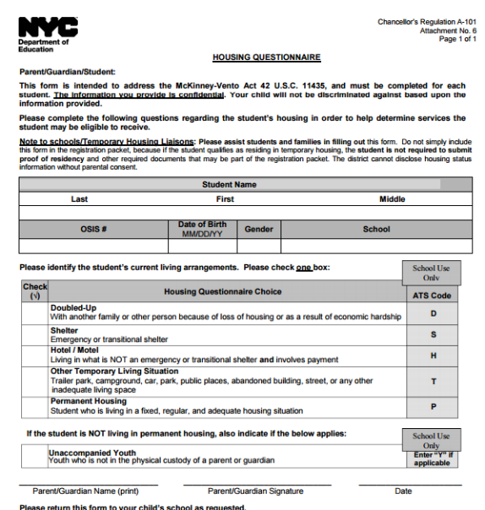
Housing Questionnaire
All students must be given the Housing Questionnaire at enrollment and if there is an address change.
Notes:
The school-based liaison or other appropriate staff person such as a pupil accounting secretary ensures that a housing questionnaire is filled out whenever a student enrolls or changes their address. Note that a student who is living in temporary housing should be immediately enrolled. It is important that an updated address be added to ATS to facilitate transportation requests.

Slide 8
Identification Challenges
My behavior was always good, then my behavior went from good to bad, but nobody heard my silent cry. … You don’t just get up and talk about your homelessness, there’s insecurities, there’s pride. But why weren’t they able to tell?
—Graduate student, High School Class of 2010, former participant in NYC Department of Education Students in Temporary Housing (STH) Unit supportive program
“…I think a lot of students in temporary housing get lost in the cracks, because they are not always seen as homeless—but they are. They are doubled up or constantly moving around from home to home...Or if Mom gets in a fight with her cousin, they could be out. It’s a lot of anxiety and stress for the kids. That comes out in all sorts of ways, behaviorally and academically.
—Social Work Director, Partnership with Children, working in Brooklyn public schools
Quotes are from ICPH’s Atlas of Student Homelessness 2017 (http://www.icphusa.org/new_york_city/map-atlas-student-homelessness-new-york-city-2017)

Slide 9
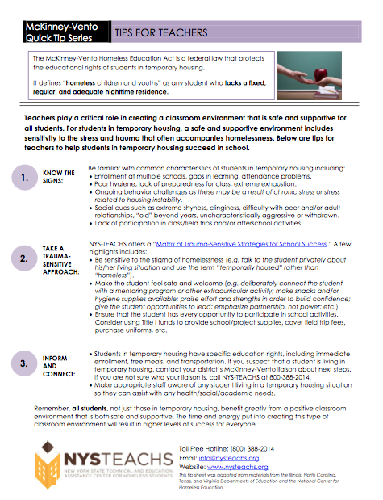
Additional Identification Tips
Housing Questionnaire (required form)
Use ATS reports, including STHM database (students in shelter entered by Family Assistants).
See Students in Temporary Housing: Data Entry in ATS - Manual for NYC DOE School Staff, on this page: nysteachs.org/info-topic/statistics.html
Learn to recognize the common signs of homelessness (Review NYS-TEACHS’ Tip Sheets series for suggestions)
Notes:
In addition to the housing questionnaire, there a few way to pro-actively identify students who may be experiencing homelessness.
For example, you may want to run an ATS report to see which students are listed as living in a shelter (we’ll talk more about how to do that later).
You also can share any of NYS-TEACHS’ “Tip Sheet” series with various staff at your school. The Tip Sheets give recommendations for what to look out for and what to do if you suspect a student may be experiencing homelessness. We have tip sheets for teachers, transportation directors, school counselors, just to name a few.

Slide 10
Addressing Common Identification Challenges
Parents/youth hide their homelessness because of embarrassment or fear.
  Do not use the word “homeless;” use “students in temporary housing” or similar language.
Parents/youth do not know that their living situation may entitle their child/them to certain protections.
  Be transparent about questions and explain the protections and services available to children who are homeless (e.g., eligibility, priority enrollment).
  Use language that reflects the living arrangement, e.g. “doubled-up” or “staying at a shelter.”
Parents/youth don’t want everybody to know about their circumstances and are worried that that information might be used to negatively stereotype their child/them.
  Discuss living situation in an office where other parents, staff, and students can’t overhear.
  Share how the information will be used (e.g., it will only be shared with staff on a need-to-know basis; program is required to report data on temporary housing).
  Provide internal trainings to staff to increase awareness and sensitivity.
What other challenges might there be and how would you address them?
Notes:
Avoid using the word “homeless” with families, youth, school staff, etc. Be aware that families do not need to self-describe as “homeless” to receive services under MV.
There are many reasons why parents and youth may be afraid to come forward with information about their living situation. For example, they may fear that homelessness will stigmatize them or cause them to lose custody of their children. Districts must make reports to Child Protective Services when necessary, but MV status in and of itself does not mean an automatic referral to ACS.
Parents also may simply not know that their living situation is covered by the McKinney-Vento Act. They may even think that over-exaggerating the stability of a living situation will be beneficial.
Ask: What other challenges might there be and how would you address them?

Slide 11
DOE’s Students in Temporary Housing Program
Central Office
Office of Safety and Youth Development
Develop citywide STH programs
Borough Offices
STH Content Experts &
STH liaisons at Borough Field Support Offices
Coordinate resources/programs for STH students
Shelters
STH Family Assistants & Attendance Teachers
Coordinate transportation, enrollment, etc.
Schools
School-Based Liaisons &
Social Workers in high-need elementary schools
Identify students in temp housing, connect with
school services such as Title I programs, provide counseling, etc.
Notes:
Roles are described in more detail on DOE’s website: http://schools.nyc.gov/NR/rdonlyres/714D6E24-A5D7-49AB-A6BD-EEB7CE5211A2/0/STHrolesJuly2016.pdf

Slide 12
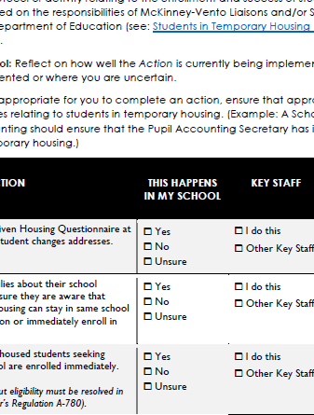
Role of the School-Based Liaison
DOE’s list of Students in Temporary Housing Roles and Responsibilities, including the responsibilities of the School-Based Liaison
The School-Based Liaison Action Plan Worksheet is a checklist created by NYS-TEACHS as a resource to supplement materials and directives from NYC DOE.
Notes:
DOE’s list of school roles: http://schools.nyc.gov/NR/rdonlyres/714D6E24-A5D7-49AB-A6BD-EEB7CE5211A2/0/STHrolesJuly2016.pdf
NYS-TEACHS worksheet: http://www.nysteachs.org/media/SBL_Responsibilities_Worksheet.pdf

Slide 13


Overview of NYC Shelter Systems
DHS Family Shelters
Run by Department of Homeless Services (DHS)
Single point of entry at PATH: 151 East 151st Street, Bronx
Approximately 150 shelters, including:
  Commercial hotels
  Tier II’s
  cluster sites
  converted hotels
Average length of stay: 14 months
DV Family Shelters
Run by Human Resources Administration (HRA) for survivors of domestic violence.
  Access through PATH or 1-800-621-HOPE (4673)
RHY Shelters
Run by Department of Youth and Community Development (DYCD) for runaway and homeless youth (RHY)
HPD Shelters
Run by the Department of Housing Preservation and Development (HPD) for families who have been displaced because of fire, flood, or vacate order.
Notes:
It is helpful to know that there are four main shelter systems in New York City. This is particularly important to know when providing transportation information to families.

Slide 14
Meet Caroline
2nd Grader in Sunset Park.
Family was kicked out of their Sunset Park apartment.
They are now sleeping on couches and air mattresses in Jackson Heights with Caroline’s aunt.
Caroline is upset that she may have to switch schools and leave her friends and teachers.
Notes:
To illustrate MV eligibility, we are going to use the (fictional) story of Caroline.
When Caroline comes back to her second grade classroom from recess one day in early winter, her teacher can immediately see that Caroline has been crying. Her teacher pulls her aside to talk. Caroline explains that her friends had been talking about what they are excited to do when springtime comes, and Caroline is worried that she won’t be here to play with them. Caroline confides that she and her family were kicked out of their apartment in Sunset Park and are sleeping on couches and air mattresses at Caroline’s aunt’s home in Jackson Heights. The commute is long, and Caroline’s parents have suggested that she will probably need to switch schools unless they find a new apartment soon. Caroline is devastated about the possibility of losing her friends and anxious about her family’s living situation.

Slide 15



School Selection: Up to three options
School attended when last permanently housed (“School of Origin”)
School most recently attended (Also a “School of Origin”)
School serving area
where student is temporarily living
(School of Current Location)
Notes:
When a student has been identified as living in temporary housing (i.e. MV eligible), they have up to three options for which school to attend.
A student can always attend the school:
Where the student was last permanently housed
Where the student last attended/was enrolled
Where the student currently lives in permanent housing
Who decides where a child will attend:
Parent/Person in Parental Relation
Youth, (together with the homeless liaison) if the youth is unaccompanied
Director of a runaway and homeless youth residential program in consultation with the youth.
Liaisons should encourage parents to keep their children in the school of origin if it’s in their best interest.

Slide 16
School Selection Conversations
Have a conversation with the parent(s) or unaccompanied youth about:
  The definition of a student and/or unaccompanied youth experiencing homelessness under the McKinney-Vento Act and Chancellor’s Regulation A-780 (be sure to use sensitive language when discussing a family or youth’s homeless status);
  The right to enroll in school immediately and/or stay connected with their school of origin when in the best interest of the student (make sure to also talk about the importance of school stability!);
  The right to transportation, including the type(s) of transportation the family/youth is eligible for, commute time, and transportation request process;
  The dispute resolution process;
  Services or supports the child/youth may be in need of, including in-school supports, extracurricular supports, housing or health referrals, etc.,
  How to contact the Students in Temporary Housing (STH) program staff if the parent or youth has any questions or would like more information about available supports.
See NYC DOE’s Students in Temporary Housing Guide for Parents and Youth
Notes:
Definition of homeless and using sensitive language: try to avoid the work “homeless” and instead refer to students in temporary housing. Make sure to let the parent/youth know that you want to ask about their housing arrangements because students who living in certain types of temporary housing situations get additional services.
Enroll in school immediately: students who are MV eligible can enroll in school even if they are missing some or all of the paperwork normally needed for enrollment.
Stay connected with their school of origin: make sure to talk about the importance of school stability with parents and youth. Children and youth who stay in the same school connected to their same friends and teachers (and other school staff) are better able to cope with the stress of homelessness because they have that support system at school. Kids who frequently transfer schools are absent more, get lower test scores, are more like to repeat a grade, are more likely to get in trouble in school, and even more likely to drop out.
Transportation: Make sure that parents know that busing is available for students in grades k-6 if the student is in shelter. Busing can also be requested for students living in other types of temporary housing situations but it’s not guaranteed. Make sure parents know that it may take several weeks to set up busing so that they are prepared to take their child on public transportation. Schools must give students in temporary housing full-fare Student MetroCards. Make sure that parents know that they can get weekly MetroCards from the STH Content Experts or shelter-based STH Family Assistants. Make sure the parent knows to call the STH Content Expert with any problems with transportation.
Dispute resolution: if there is a delay or a disagreement about enrollment or transportation, make sure that the parent knows to contact the STH Content Expert and Marygrace about starting the dispute resolution process.
Services and supports: ask the parent/youth what types of supports the student may be in need of and make appropriate referrals. Remember that Title I set-aside funding is available to support students in temporary housing (for example, it can be used to buy school supplies, school clothes, etc.). Also STH program offers after-school and summer programming. Contact the STH Content Expert for more information.
Contacting STH staff: make sure parents and youth understand the role of the Content Experts and Family Assistants and how to contact them.

Slide 17
If a student is temporarily housed, which of the following records does a new school need before they can enroll the child in school?
Poll
School records and medical/immunization records
Signed Affidavit from the person/relative hosting the family
Birth Certificate
All of the above
None of the above
Notes:
Answer = E
See next slide

Slide 18

Immediate Enrollment
School must immediately enroll the student in temporary housing, even if they are unable to produce records normally required for enrollment.
Children must immediately be admitted to school while proof of birth, immunization, and other school records are being located and/or verified.
Notes:
In NYC, students are often enrolled at an Enrollment or Family Welcome Center. If and when School-Based Liaisons and other staff encounter students in temporary housing looking to enroll, they must ensure that enrolment is processed immediately by the school or enrollment center.
Chancellor’s Regulation A-780(III)(B)
Enrollment Assistance
Family Assistants shall assist parents in enrolling students in school in coordination with and in accordance with the procedures of the Office of Student Enrollment. Homeless students, including students with disabilities, may be referred to the Borough Enrollment Office for school enrollment or transfer purposes.
The school selected shall immediately enroll the homeless child or youth, even if the child or youth is unable to produce records normally required for enrollment, including: proof of residency; transcripts/school records; immunizations or other health records; birth certificate. Family Assistants and school staffs are required to assist parents or unaccompanied youth in obtaining such documents. If immunization records cannot be obtained, the parent, in consultation with the STH Liaison(s), should be referred to a walk-in immunization clinic for assistance.
Children must immediately be admitted to school while proof of birth, immunization, and other school records are being located and/or verified.

Slide 19
What if there’s a disagreement about eligibility?
If a dispute arises, the DOE must:
  Immediately admit student to the school/district where enrollment is sought and provide transportation
  Make every effort to resolve dispute informally
  Loop in the borough Content Expert, who will assist in following the dispute procedures in Chancellor’s Regulation A-780
  The DOE must give the parent/guardian/youth a written explanation of the school’s decision and refer the student/family to the STH Content Expert for help with any appeal.
  The parent/unaccompanied youth has 30 days from the date of the decision to file an appeal with the State Commissioner of Education.
Notes:
Dispute Resolution is described in Chancellor’s Regulation A-780(IV)

Slide 20
What about younger siblings?
EarlyLearn, Head Start, and Pre-K Services
If a student in your school is experiencing homelessness, find out if they have younger siblings.
To find the closest early childhood education programs in any NYC neighborhood:
Call 311 or the Child Care Resource and Referral Consortium
at (888) 469-5999
Or Visit:
  http://www.nyc.gov/html/acs/html/child_care/earlylearn.shtml for information about EarlyLearn NYC programs.
  http://eclkc.ohs.acf.hhs.gov/hslc/HeadStartOffices#map-home for information about Head Start programs.
  http://schools.nyc.gov/prek for information about pre-k in public schools and community-based organizations.
Notes:
Did you know that a person in the U.S. is most likely to experience homelessness in the FIRST YEAR of life? A person is next most likely to experience homelessness at ages 1 to 5. And almost half of children in shelter are under age 6. It is incredibly important to connect families with young children to early childcare and education programs. https://aspe.hhs.gov/sites/default/files/pdf/214191/Infographictext.pdf
Children ages 6 weeks through 4 years experiencing homelessness are eligible for early education programs and services, but many families are not aware of that. You can help kids get the best start possible by asking a family if there are younger children in the home who may benefit from programs such as Early Learn, Head Start , and Pre-K.
EarlyLearn NYC Programs: Available to children who are 6 weeks old through 4 years old. EarlyLearn NYC programs offer a combination of Prekindergarten (Pre-k), Head Start, and/or child care depending on the site. The ages of children served vary by location. EarlyLearn NYC programs are open all year and offer full-day programs.
Head Start and Early Head Start Programs: Available to children who turn 3 or 4 years old by December 31. Children living in shelters are categorically eligible for Head Start. Head Start programs are open all year, and offer full-day or half-day sessions. Head Start programs are available at many EarlyLearn NYC locations and also from other providers.
Prekindergarten (also known as pre-k): Available to children who turn 4 years old by December 31. Pre-K is offered at public schools and at community-based early childhood centers (CBECC’s) during the school year. Parents should call or visit the public school or CBECC program to enroll.

Slide 21
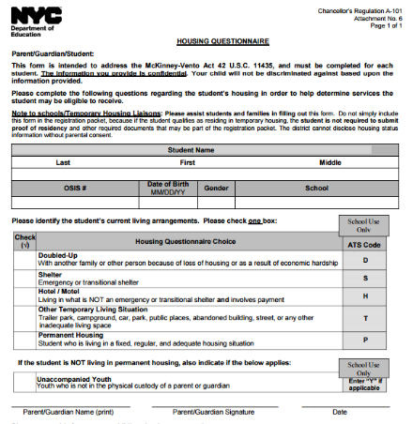

Update housing status and student address in ATS according to information from the Housing Questionnaire.
Housing Questionnaire Choice | ATS Code
Doubled-up (D) with another family or other person because of loss of housing or as a result of economic hardship | D
Shelter (S) Emergency or transitional shelter | S
Hotel/motel (H) NOT an emergency or transitional shelter and involves payment | H
Other temporary living situation (T) Trailer park, campground, car, park, public place, abandoned building, street, or any other inadequate living space | T
Permanent housing (P) Student who is living in a fixed, regular, and adequate housing situation | P
Notes:
The housing code marked off on a student’s Housing Questionnaire must be entered into ATS. If you are not the Pupil Accounting Secretary or the person responsible for data entry, you must ensure that they have this information. When you have questions about information from a student’s Housing Questionnaire, follow up with them to obtain accurate information about their housing status. Conversations about housing status should also take place in private spaces, such as an office, to provide the parent or unaccompanied youth with a sensitive environment and to maintain confidentiality.
The UY box should be checked, and subsequently entered into ATS, if student is not in the physical custody of parent/guardian AND living in temp housing. Homeless Unaccompanied Youth have the same rights as other students in temporary housing, including immediate enrollment and transportation.
It is VERY IMPORTANT that in addition to updating a student’s housing status in ATS, you update their address information to reflect their current temporary address. Up-to-date address information is needed in order to process transportation requests. Oftentimes, school delays updating a student’s address result in transportation delays, which can increase tardiness and absences.

Slide 22
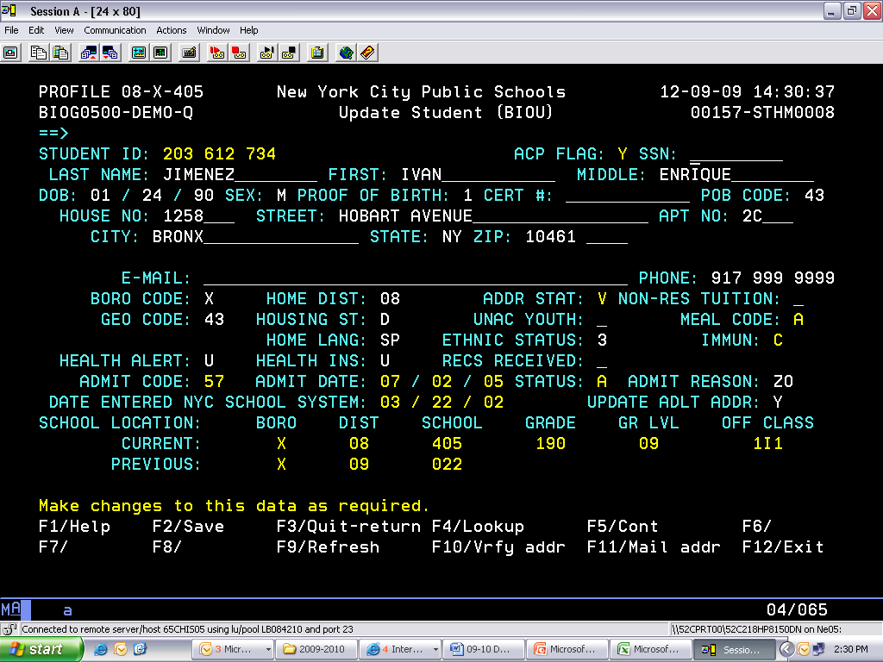
ATS: Student Biographical Update (BIOU) Screen
1) Place cursor next to HOUSING ST(atus) and select F4.
2) Enter Unaccompanied Youth status (Y or N), only if the student is in temporary housing.
3) Make sure to also update the student’s address
Notes:
BIOU screen
HOUSING ST
D – DOUBLED UP
H – HOTEL / MOTEL
N – FORM NOT RETURNED
P – PERMANENT HOUSING STATUS
S – SHELTER
T – OTHER TEMPORARY LIVING SITUATION
UNAC YOUTH
Y(es)
N(o)

Slide 23
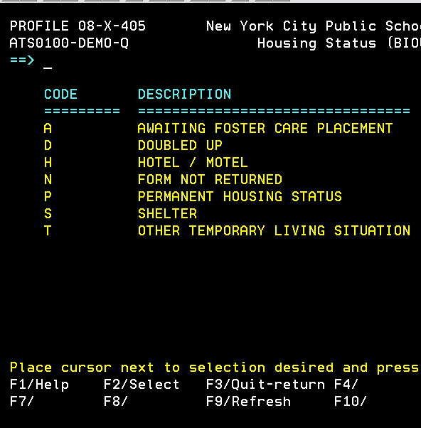
Run reports in ATS
Follow up with students who do not return the Housing Questionnaire. (N = FORM NOT RETURNED; M = MISSING)
More information about data entry + reports to run in the NYS-TEACHS’ ATS Guidebook: http://www.nysteachs.org/media/Data_Entry_Handbook_030217.pdf
Notes:
Schools must run several reports a year to ensure that data on students in temporary housing are entered correctly.

Slide 24
Special note about DV Shelter Addresses
DO NOT USE THE STREET ADDRESS! Instead, please use…
House #: Enter number of P.O. Box for the DV Shelter
Street: “No Name”
Zip: Zip of shelter
If the student has an IEP…
  Update SESIS to ensure that the IEP team communicates
  with the appropriate parent(s) or guardian(s).
Notes:
A special note about families living in Domestic Violence shelter. When you are updated the address in ATS, please do not put the actual street address. This is for two reasons:
The student’s safety is a concern so we don’t want the physical address to be part of his/her record
Busing is routed by the P.O. Box number which is linked to a shelter code for OPT. If you put the real address is, OPT won’t route a bus.
Note that if the family has privacy concerns, they may be noted in ATS but the special education database, SESIS, or other databases may not have information about the family’s privacy needs.

Slide 25
Caroline is a second grader doubling up in Queens and attending school in Brooklyn. What type(s) of transportation is/are available to her?
Poll: Transportation for Caroline
MetroCard for Caroline only
MetroCard for Caroline and her parent/guardian
Busing (if an appropriate route exists)
A and C
B and C
Notes:
Remember Caroline? Caroline’s family wished to keep her enrolled in her school of origin in Brooklyn. They are currently temporarily doubled-up with a relative in Queens.
ANSWER IS E.
Metro card for Caroline and her parent/guardian AND busing is possible IF an appropriate route exists.

Slide 26

Transportation to School: Overview
BUSING
ALL K-6 students in shelters;
Any grade if on IEP;
For doubled-up and other
K-6 students if a route exists
or
METROCARD
FREE full-fare MetroCard for any student in temp housing not getting busing
Parent to accompany student (Pre-K-6)
Notes:
Yellow bus service is provided to students in grades K-6 in shelters, and for other students in temporary housing if an appropriate route exists to provide such service.
While busing is being arranged or if a yellow bus route does not exist, the Family Assistant should provide the student with a MetroCard and the parent if he or she accompanies the youth to and from school.
Busing should be arranged within 5 business days.
If there is a delay in transportation or if there are any problems or questions, contact the STH Content Expert for your borough or NYS-TEACHS.
Although it is true that busing is available to all K-6 students in shelters, there is one exception: If the shelter and the school are less than ½ mile apart the student is not eligible. This aligns with DOE’s general eligibility rules based on distance. If you have a family that lives close to school but needs transportation assistance, contact NYS-TEACHS.
Busing for kids in DHS shelters
All students in grades K-6 who are in shelters overseen by DHS will be routed for busing automatically. Caseworkers should give parents the telephone number for the DOE’s Office of Pupil Transportation (OPT) so that they can find out the bus route # and details about pick-up and drop-off.
Busing for kids in DV shelters
Students in DV shelters will also receive busing. But for safety and security reasons, busing is not automatically routed like it is for students in DHS shelters. To arrange for busing for child in a DV shelter, the parent or caseworker should use the Temporary Housing Transportation Request form.
Busing for kids who have IEPs that include door-to-door busing
Students who receive special education services have Individualized Education Plans or IEPs. Some students have door-to-door busing listed on their IEPs. These students will also receive busing, but PARENTS must make sure that their children’s SCHOOL UPDATES THE STUDENT’S ADDRESS. Busing will routed for the address that the school has for the child so if the school hasn’t updated the address to the shelter address, then the child will not be routed for busing.
MetroCards
School will provide a free, full-fare MetroCard to students not getting busing. Until the school gives the student a MetroCard, MetroCard available from the STH Family Assistant or Content Expert.
Parents are also eligible for free MetroCards to accompany their children to and from school if kids are in grades pre-k though 6th grade. Parents can get the MetroCard from the STH Family Assistant or STH Content Expert.

Slide 27

In the interim…
MetroCards should be issued while awaiting bus route implementation or response about bus route availability.
Notes:
If waiting for a bus to be set up or after submitting a bus request, Metrocards should be issued. STH staff at the shelter or borough office can give the student Student MetroCards and the parent weekly MetroCards if the family is waiting for busing to be routed or for a response about bus route availability.

Slide 28
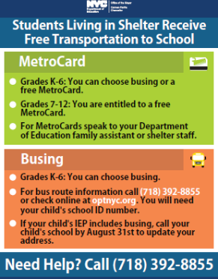
Busing for students in grades K-6 in Department of Homeless Services (DHS) Shelters
Busing set up automatically for students in grades
K-6 who reside in DHS shelters.
To find bus routes, parents can:
Call OPT’s Customer Service line at (718) 392-8855
Check online at http://www.optnyc.org (Need child’s OSIS number and date of birth)
Talk to the STH Family Assistant at shelter site or borough-based STH Content Experts
Notes:
Busing for students in Department of Homeless Services (DHS) shelters. Students in grades K-6 (all students) and students in 7th and 8th grade (if rec’ing spec ed services and don’t already receive busing) who are in shelters overseen by DHS will be routed for busing automatically if family has been found eligible for shelter. No request for busing needs to be submitted. Call OPT (718-392-8855) customer service line number so that they can find out the bus route # and details about pick-up and drop-off.

Slide 29
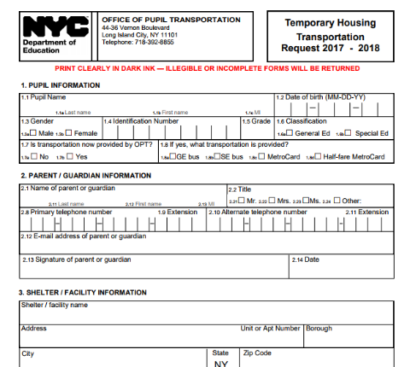
Busing for students in grades K-6 in Domestic Violence Shelters
Caseworkers at Human Resources Administration (HRA) Domestic Violence Shelters (DV Shelters) can request busing via email using the Temporary Housing Transportation Request form.
School-Based Liaison will make sure that student address is updated in ATS (REMEMBER TO USE THE PO BOX)
Parent updates Housing Questionnaire and shares with school, or school shares updated HQ with parent/ shelter caseworker
Temporary Housing Transportation Request form completed
Shelter Caseworker will email the completed form to all required parties:
  OPTShelterTransportationRequests@schools.nyc.gov
  CC: STH Content Expert for temporary housing location
Note: All students in DV shelters meeting grade and distance requirements should receive busing.
Notes:
Often, it is the caseworker at the DV shelter who will actually turn in the request, but you can help by contacting the family’s caseworker (if appropriate) and letting them know where the form is.
Busing for students in Domestic Violence (DV) shelters. Students in grades K-6 (all students) and students in 7th and 8th grade (if rec’ing spec ed services and don’t already receive busing) who are in DV shelters are eligible for busing.
Request that school update address in ATS. Make sure correct P.O. Box.
Parent completes Housing Questionnaire: http://schools.nyc.gov/NR/rdonlyres/9831364D-E542-4763-BC2F-7D424EBD5C83/209218/HousingQuestionnaireRevised1.pdf
Complete Temporary Housing Transportation Request: http://www.optnyc.org/resources/TemporaryHousingRequest.pdf
Email the completed Housing Questionnaire and Temporary Housing Transportation Request:
▪ To: OPTShelterTransportationRequests@schools.nyc.gov
▪ CC: STH Content Expert for the borough where temp housing is located:
▪ RE: ATS School Code; Student Last Name; Student First Name; OSIS Number; and a brief
indication of subject or issue in subject line.
o For example: 07X001 - Smith, Jane – OSIS 123-456-789 – Busing for student in DV shelter
▪ Busing should be routed 5-7 days after OPT receives the Transportation Request.
STH Content Expert for the borough where temp housing is located: http://schools.nyc.gov/NR/rdonlyres/6C02DF12-F56D-4024-BE84-EA5B6A51A7B9/0/STHContactInformationFORDISTRIBUTION_RCedits.pdf

Slide 30
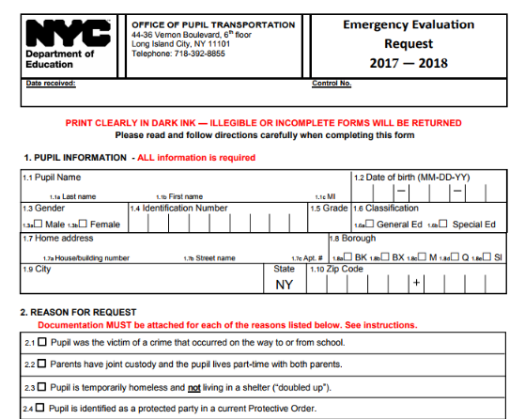
Busing for students in grades K-6 who are doubled-up or who have moved into permanent housing
Students who are temporarily doubled-up, in another temporary housing situation not in shelter, or who have moved into permanent housing from a homeless situation can request busing via email using the Emergency Evaluation Request form. Note that students will only receive busing if an appropriate bus route exists.
School-Based Liaison will make sure that student address is updated in ATS
Parent updates Housing Questionnaire.
Emergency Evaluation Request form completed
Email the completed form to all required parties:
  OPTEmergencyTransportationRequests@schools.nyc.gov
  CC: STH Content Expert for temporary housing location
Notes:
Students who are temporarily doubled-up or who were homeless and have moved into permanent housing may be able to receive busing if there is an appropriate bus route.
Request that school update address in ATS. Make sure correct P.O. Box.
Parent completes Housing Questionnaire: http://schools.nyc.gov/NR/rdonlyres/9831364D-E542-4763-BC2F-7D424EBD5C83/209218/HousingQuestionnaireRevised1.pdf
Complete Emergency Evaluation Request: http://www.optnyc.org/resources/EmergencyEvaluationRequest.pdf
Email completed Housing Questionnaire and Emergency Evaluation Request:
To: OPTEmergencyTransportationRequests@schools.nyc.gov
CC: STH Content Expert for the borough where temp housing is located: http://schools.nyc.gov/NR/rdonlyres/6C02DF12-F56D-4024-BE84-EA5B6A51A7B9/0/STHContactInformationFORDISTRIBUTION_RCedits.pdf
RE: OPT School Code/ATS School Code; Student Last Name; Student First Name; OSIS Number; and a brief indication of subject or issue in subject line
If busing is not available, school should provide the student with full-fare MetroCard and if the student is in grade K-6, STH staff should provide the parent with a MetroCard.

Slide 31
If student has transportation listed as a related service on IEP
Student eligible for busing regardless of temporary housing status, distance, and student’s grade level
No Variance/Evaluation Request necessary, but ensure that these steps are taken:
School must update address on the BIO screen in ATS
Transportation Coordinator in the Borough Field Support Center (BFSC) must update the STRE screen in ATS. Note that District 75 schools have direct access to STRE screen.
OPT re-routes student and contacts parent with updated busing information.
Notes:
Busing will not automatically be routed for students who have busing on their IEP who are living in a shelter (unlike their peers without IEPs). It is very important the following steps be taken.
Parent requests that school update address in ATS (BIO screen).
School requests that Transportation Supervisor in the Borough Field Support Center (BFSC) update the address in ATS (STRE screen).
Updated information from ATS goes directly to OPT after STRE screen us updated
OPT re-routes the student
OPT contacts parent with updated busing info
To troubleshoot, parents can contact OPT customer service 718-392-8855
NOTE about District 75. The process for D75 is slightly different from community school district schools. The transportation supervisors at the BFSC are not involved in busing for kids in D75 schools, because D75 schools have access to the STRE screen (unlike community school district schools) and should be updating both the BIO and STREE screens with the new address information.
WHILE WAITING FOR BUSING TO BE RE-ROUTED:
DOE published a policy where it will reimburse a parent for transportation costs if there is a delay in arranging for transportation mandated on an IEP. According to this new policy, the parent should contact “your DOE representative” if “Due to financial hardship, you are unable to pay for transportation and await reimbursement; the Representative will issue a Metro Card or make other arrangements where appropriate.”
The DOE representative mentioned on the form is the administrator in charge of processing special education transportation for the student, which depends on what type of school the student attends. For students in community schools, it would be the Network’s Administrator of Special Education; for students in District 75 schools it would be a central District 75 administrator; and for preschoolers or school-age students attending charter or non-public schools, it would be a member of the staff at the district Committee on Special Education that serves the student. (In most cases, this is the person who would be issuing the form to the family.)
The form is here:
http://schools.nyc.gov/NR/rdonlyres/DB9AA5F4-7F33-423F-937B-8B5AA177D43A/0/ParentGuardianTransportationReimbursementVoucherFormTRV1072214.pdf
A description of scenarios where the form applies is here:
http://schools.nyc.gov/Academics/SpecialEducation/programs/relatedServices/RSinformation.htm

Slide 32
MetroCards
School provides full-fare Student MetroCard for students not eligible for busing. If Student MetroCard is not available from the school, students can get daily Student MetroCards from STH Family Assistant or Content Expert.
For students in grades PK-6 who do not have a bus route, parents/guardians can get FREE weekly MetroCards to bring their child(ren) to school. Available from the STH Content
Experts/Family Assistants.

Slide 33

Busing Requests: Who can help?
OPT Customer Service (718) 392-8855
    Make sure to specify whether it’s a:
    Special Ed Bus Request OR
    DHS Bus Request
    HRA/Other Bus Request OR
    Emergency Evaluation Request (for STH not in shelter)
Still having trouble, call:
    STH Content Experts
    NYS-TEACHS (800) 388-2014
Notes:
SED applies a 5 business day standard for yellow bus transportation requests in NYC, after which you should follow up with us about the delay and reach out to OPT for more information.

Slide 34
Students Experiencing Homelessness are Categorically Eligible for Title I Services
Academic programs and educational support services
Basic/emergency supplies
Extended library hours/after school programs
Counseling services
Parental involvement
Intervention programs
Outreach efforts to identify the STH population and help them
The work of the liaison
Research based programs that benefit highly mobile students
Data collection to assess the needs/progress of STH
Work with school leadership to develop a list of possible supplies and services and a process for accessing funds. Ensure that all students in temporary housing are connected with appropriate services.
Notes:
Title I set-aside funds should be used primarily for educational services to ensure homeless children and youth progress academically. However, due to the different needs of students experiencing homelessness, Title I funds may be used to pay for emergency supplies such as uniforms, school supplies, books, or even glasses. The list here highlights some examples of allowable use uses of Title I funds.
These uses correspond with categories in Galaxy.

Slide 35
Title I for Students in Temporary Housing
A school’s Title I set-aside is used to assist students in temporary housing in meeting academic standards as well as assisting with urgent needs, such as emergency supplies.
All students in temporary housing are eligible, regardless of whether or not they attend a Title I school.
See:
  NYC DOE, NCLB Mandatory Title I, Part A Set-Aside for Students in Temporary Housing – Frequently Asked Questions
  NCHE Brief, Serving Students Experiencing Homelessness under Title I, Part A http://center.serve.org/nche/downloads/briefs/titlei.pdf

Slide 36

Title I Set-Aside
Title I School
Min $100 x # of STH
Non-Title I School
Title I per pupil amt x # of STH
Uses
Academic and support services for students in temporary housing
Notes:
Title I schools are required to set aside or schedule a minimum of $100 per STH pupil. In determining how much to set-aside for STH, schools must factor in their responsibility for covering emergency supply needs (such as school uniforms) for the entire year.
Non-Title I schools are required to schedule the per capita funding as indicated by borough.
SY18 (Prelim)
City-Wide: $909.19
Manhattan: $801.41
Bronx: $1,070.24
Brooklyn: $966.80
Queens $705.77
Staten Island $1,056.97
If you’re from a non-Title I school, you can see you school’s STH Title I allocation here: http://schools.nyc.gov/offices/d_chanc_oper/budget/dbor/allocationmemo/fy17_18/fy18_pdf/sam08.pdf
For more information on the acceptable usage of the mandated Title I, Part A set-aside to support your STH population, please refer to the Title I, Part A Set-Aside for Students in Temporary Housing Frequently Asked Questions document on DOE's website.

Slide 37
Title I services and programs for Caroline
Let’s pause and revisit Caroline’s story again.
Does her school require uniforms?
Was she able to take school supplies with her to Jackson Heights or does she need new ones?
What are her interests? Is there an after-school club that would meet those interests?
Would Caroline benefit from individual or group counseling as a result of stress from housing instability?
Notes:
Title I dollars can be used to ensure that students in temporary housing get the services and supplies they need. If you work at a Title I school, think about how to proactively connect students in temporary housing to existing Title I services and programs, in addition to connecting these students with programs and supplies paid for with set-aside funds. And, of course, all schools should pay close attention to existing school programs that students in temporary housing would benefit from.

Slide 38
School-Based Liaisons must inform homeless unaccompanied youth of their status as independent students for college financial aid on the FAFSA, and must give them verification of their independent student status.
Schools must assist all students in temporary housing with college access resources.
Unaccompanied homeless youth have the right to apply as independent students for college financial aid. SBLs have obligations to assist these youth with documentation of their status:
  FAFSA’s Application and Verification Guide describes guidelines in detail: https://ifap.ed.gov/ifap/byAwardYear.jsp?type=fsahandbook.
  NAEHCY tip sheet - Who can Make a Determination of Unaccompanied Homeless Youth Status http://www.naehcy.org/sites/default/files/dl/legis/fafsa-who-deter_Sept2016.pdf?
Notes:
Homeless unaccompanied youth have all of the rights of students who are homeless who are living with their parents:
Immediate enrollment. And in the case of unaccompanied youth, they are entitled to immediate enrollment without a parent or legal guardian. (If asked: Unaccompanied youth, either permanently housed or homeless do NOT need a parent or guardian to enroll in school.)
Title I services
Free transportation
Free meals
Schools have to ensure that they receive full or partial credit for coursework successfully completed
Access to college counseling
In addition, homeless unaccompanied youth qualify as independent students for purposes of federal financial aid.
From the US DOE Non-Regulatory Guidance:
Q-2. How can local liaisons support unaccompanied homeless youths in applying for Federal financial aid for postsecondary education?
Local liaisons must ensure that unaccompanied homeless youths are informed of their status as independent students under section 480 of the HEA (20 U.S.C. 1087vv). (Section 722(g)(6)(A)(x)(III)). Local liaisons also must assist youths with receiving verification of such status for federal student aid purposes. (Section 722(g)(6)(A)(x)(III)). This status is important because independent students do not need to provide parent information on the FAFSA, and an independent student’s Federal financial aid package is calculated without the expectation of parental financial support. A local liaison may continue to provide verification of a youth’s status as either unaccompanied and homeless, or as self-supporting and at risk of being homeless, for federal student aid purposes for as long as the liaison has access to the information necessary to make such a determination for a particular youth. Visit NCHE’s website for sample forms for documenting independent student status for unaccompanied homeless youths. 41 For more information on independent student status, please visit the Department’s student aid website.

Slide 39
Key Takeaways
Students who lack housing that is fixed, regular, and adequate are covered by the McKinney-Vento Act, which promotes school stability.
Students can continue attending their school of origin or enroll immediately in a new local school, even if they don’t have the records normally required for enrollment.
Schools must enter information from a student’s Housing Questionnaire and a student’s current address in ATS.
Busing is available to all students in shelters (K-6) and for students in other temporary situations if a route exists (students K-6); otherwise, the student receives MetroCards. Parents of children without busing are also entitled to MetroCards to bring their child(ren) to school (if student is PreK-6).
Students in temporary housing are categorically eligible for free meals and Title I, Part A services.

Slide 40

Resources from NYS-TEACHS
Free brochures are available in English
and in Spanish
Free posters in 10 languages
Toll-free hotline 800-388-2014
Website, www.nysteachs.org

Slide 41
Key References & Resources
Laws & Regulations
  The McKinney-Vento Homeless Education Assistance Act
  New York State Education Law § 3209
  Implementation of Changes to Education Law §3209 and Commissioner’s Regulation §100.2(x), Education of Children and Youth Experiencing Homelessness
  New York City Chancellor’s Regulation A-780
New York City Department of Education Resources
  DOE’s Students in Temporary Housing website
    List of borough-based Content Experts
    Defined roles of STH Family Assistants, Content Experts, CFN STH Liaisons, STH School-Based Liaisons
    Residency Questionnaires in ten languages
    …and more resources
NYS-TEACHS – www.nysteachs.org

Slide 42
Students in Temporary Housing Content Experts
Note: Updated Content Expert Lists can be found on DOE’s Students in Temporary Housing website
Borough Center Location | Districts | STH Content Expert Name | Office Number | E-mail
Bronx 1 Fordham Plz, Rm 821A Bronx, NY 10458 | 7, 8, 9, 10, 11, 12 | Stephanie Dyer Rebekha Askew | 718-741-7783 718-828-2139 | sdyer@schools.nyc.gov raskew2@schools.nyc.gov
Brooklyn 131 Livingston Street Brooklyn, NY 11201 | 13, 14, 15, 16, 19, 23, 32 | Tony Davis Wayne Harris | 718-935-3296 718-935-3562 | tdavis47@schools.nyc.gov wharris22@schools.nyc.gov
Brooklyn South 1780 Ocean Ave., Rm 1B Brooklyn, NY 11230 | 17, 18, 20, 21, 22, 31 | Charlene Mitchell | 718-758-7722 718-758-7635 | cmitchell4@schools.nyc.gov
Manhattan 333 7th Avenue, 12th Fl New York, NY 10001 | 1, 2, 3, 4, 5, 6 | Cecilio (Bo) Diaz Iris Gersten | 917-339-1698 917-339-1718 | cdiaz@schools.nyc.gov igersten@schools.nyc.gov
Queens 28-11 Queens Plaza N LIC, NY 11101 | 24, 25, 26, 27, 28, 29, 30 | Linda Wilson-Animashaun Shaquieta Boyd | 718-391-6849 718-391-6843 | lwilson33@schools.nyc.gov sboyd5@schools.nyc.gov
Special Education 400 First Ave, Rm 114/715 New York, NY 10010 | 75 | Michele Marcel Joan E. Boreland | 212-802-1579 917-256-4262 | mmarcel@schools.nyc.gov jboreland@schools.nyc.gov

Slide 43
Housing/Shelter Resources
HomeBase (Homelessness Prevention Services) – Among the services that may be offered are:
  Family or tenant/landlord mediation
  Household budgeting
  Emergency rental assistance
  Job training and placement
  Benefits advocacy (child care, food stamps, tax credits, public health insurance)
  http://www.nyc.gov/html/dhs/html/prevention/homebase.shtml or call 311 for local sites
Family Shelter (DHS): http://www.nyc.gov/html/dhs/html/housing/families.shtml
Domestic Violence Shelter (HRA) – 800-621-HOPE (4673)
Runaway Youth Shelters (DYCD): 800-246-4646

Slide 44

NYS-TEACHS
800-388-2014
Email: info@nysteachs.org
Website: www.nysteachs.org

